Slide 1
Identifying Key Drivers of Readmission Among Diabetes Patients
A Data-Driven Analysis of Diabetes Readmissions 1999-2008

Slide 2
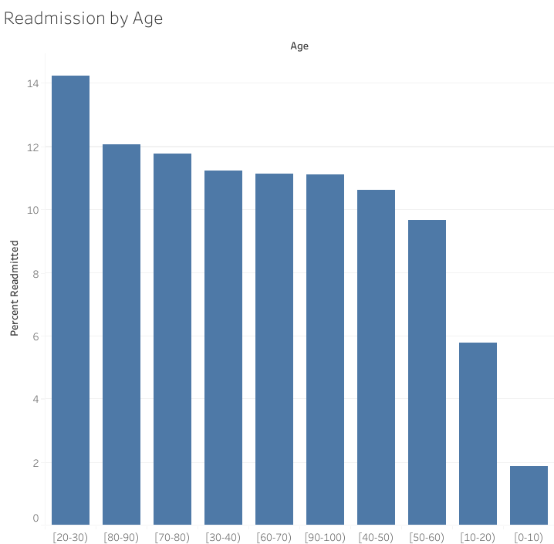
Young Adults (20-30) Show the Highest 30-Day Readmission Rate
Patients aged 20-30 had the highest 30-day readmission rate (14%).
This suggests younger patients may face unique challenges managing diabetes post-discharge.
Further analysis is needed to understand whether lifestyle factors, treatment adherence, or comorbidities contribute to higher readmissions in this age group.
Source: https://archive.ics.uci.edu/ml/datasets/Diabetes+130-US+hospitals+for+years+1999-2008

Slide 3
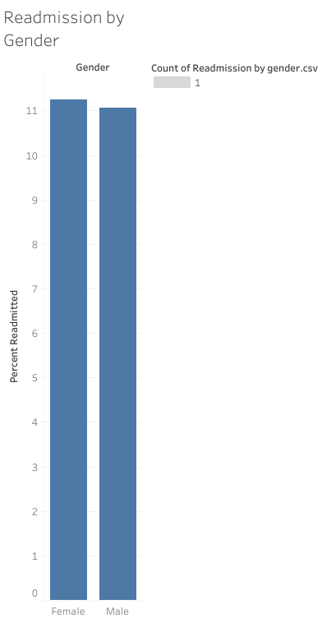
Readmission Rates Are Similar Across Gender
Females: 11.2%
Males: 11.1%
Gender does not appear to be a strong predictor of readmission compared to age.
Source: https://archive.ics.uci.edu/ml/datasets/Diabetes+130-US+hospitals+for+years+1999-2008

Slide 4
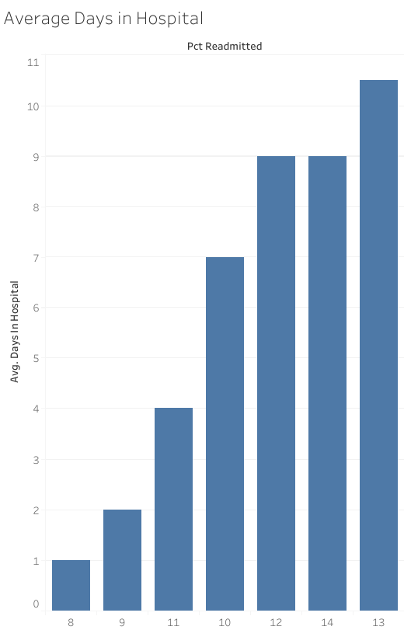
Longer Hospital Stays Are Linked to Higher Readmission Rates
Patients with longer average hospital stays showed higher 30-day readmission rates.
This may indicate more severe cases or complications leading to readmission.
Potential area for intervention: enhanced discharge planning for patients with extended stays.
Source: https://archive.ics.uci.edu/ml/datasets/Diabetes+130-US+hospitals+for+years+1999-2008

Slide 5
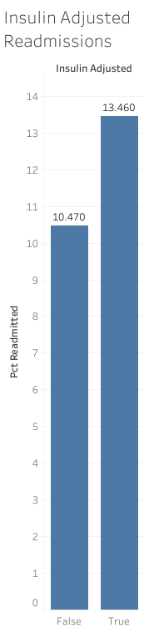
Insulin Changes May Increase 30-Day Readmission Risk
13.5% of patients with insulin adjustments were readmitted within 30 days
10.5% of patients without adjustments were readmitted.
This suggests that insulin adjustments may indicate unstable diabetes management or higher-risk patients.
Source: https://archive.ics.uci.edu/ml/datasets/Diabetes+130-US+hospitals+for+years+1999-2008

Slide 6
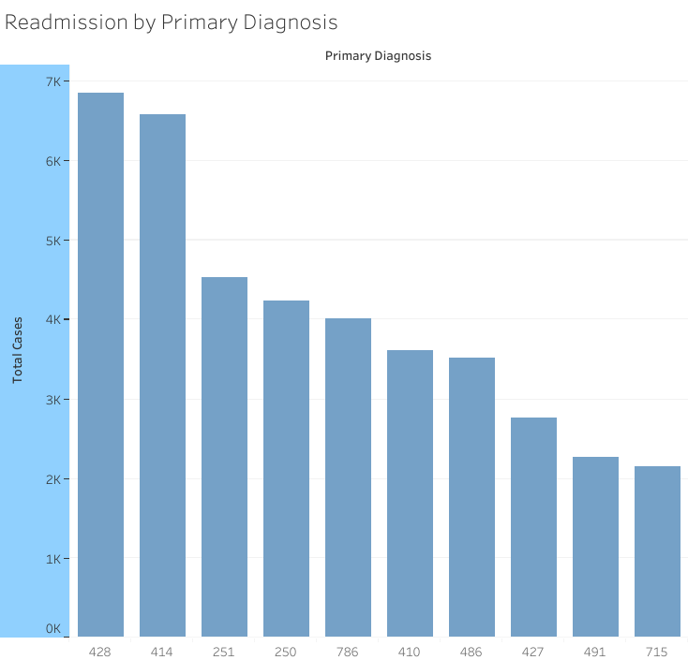
Certain Diagnoses Drive Higher 30-Day Readmission Rates
Heart failure (ICD-9 428) accounts for the highest number of readmissions in our dataset.
This indicates that patients with heart failure may require targeted post-discharge care to reduce readmissions.
Source: https://archive.ics.uci.edu/ml/datasets/Diabetes+130-US+hospitals+for+years+1999-2008

Slide 7
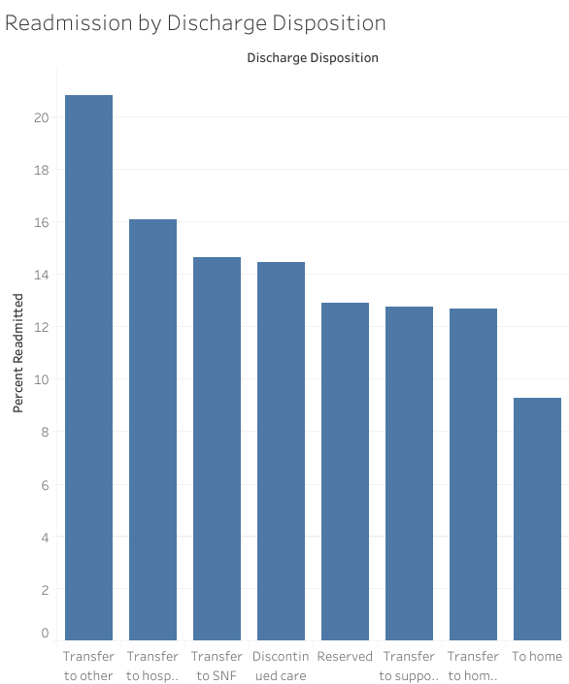
Discharge Destination: Cancer Centers Linked to Elevated Readmissions
Patients discharged to a cancer center (Discharge Disposition 05) show the highest 30-day readmission rates.
This reflects the complexity of care for oncology patients and the need for ongoing treatment or management of diabetes complications.
The data highlights the importance of specialized post-discharge planning and follow-up for this patient group.
Source: https://archive.ics.uci.edu/ml/datasets/Diabetes+130-US+hospitals+for+years+1999-2008

Slide 8
Conclusions and Insights
Young adults (20-30) had the highest 30-day readmission rates, highlighting a need for targeted follow-up in this group.
Heart failure (ICD-9 428) is the most common diagnosis driving readmissions, suggesting specialized care for these patients may reduce readmissions.
Discharge to cancer centers is associated with high readmission rates, reflecting complex care needs in oncology patients.
Gender differences are minimal; focus should be on age, diagnosis, and hospital stay length rather than gender-based interventions.
Patients with longer hospital stays and those receiving insulin adjustments are at higher risk.
Source: https://archive.ics.uci.edu/ml/datasets/Diabetes+130-US+hospitals+for+years+1999-2008

